Slide 2
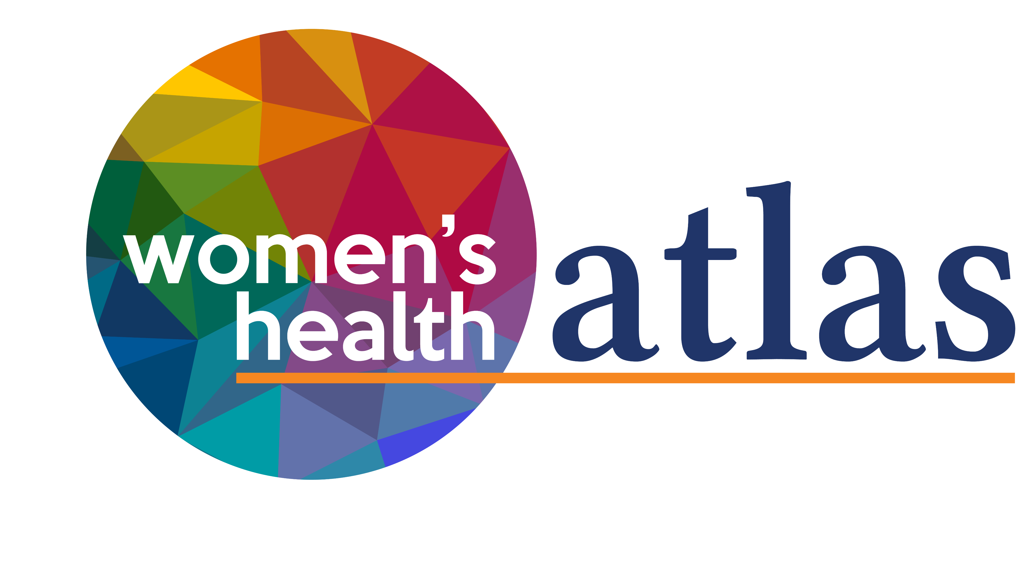
A free, interactive tool that illustrates the relationship between gender and health.
Over 50 data sets, sex disaggregated and mapped to every LGA in Victoria
SRH, Mental Health, Violence Against Women, Avoidable Mortality, Cancer, Gender Equality
Over 20,000 users and 180,000 page views

Slide 3
Violence
Sexual violence 5.6 times more likely for women than men
33% of women with a disability experience sexual violence
Women 3 times more likely than men to experience family violence
65% of women with a disability experienced violence since age 15
33% migrant and refugee women have experienced family violence
13.4% of LGBTIQ adults have experienced family violence

Slide 4
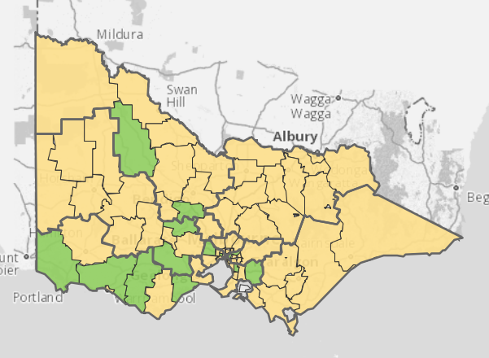
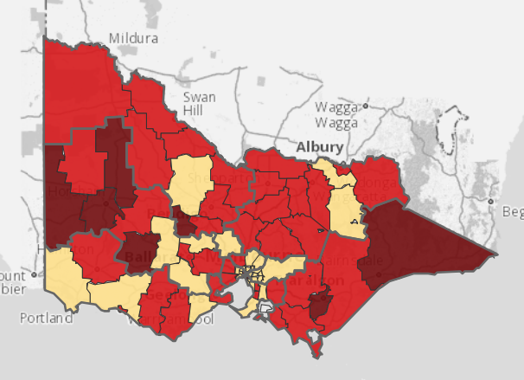
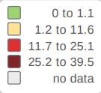
Sexual Offences (rate per 10,000)
Men
Women
Source: Women’s Health Atlas 2020

Slide 5
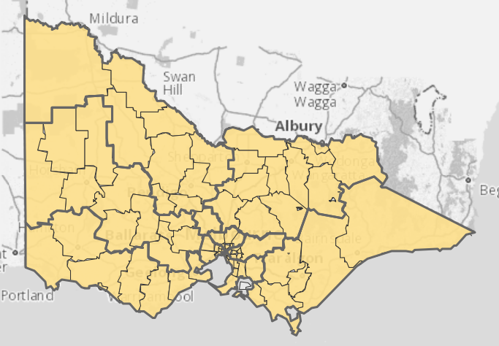
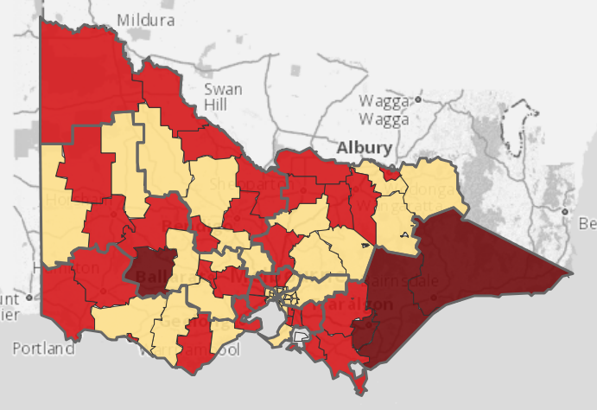
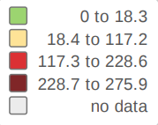
Family Violence (rate per 10,000)
Men
Women
Source: Women’s Health Atlas 2020

Slide 6
Mental Health
Mental health is the largest burden of disease due to family violence for women aged over 15
67%
of women with a disability reported experiencing harassment in the mental health system
Women who experience family violence during pregnancy are 3 times more likely to suffer depression

Slide 7
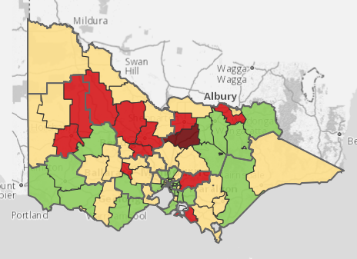
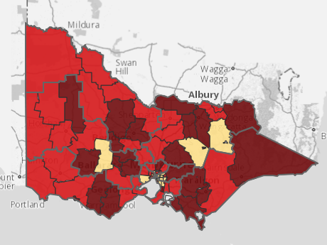
Lifetime % diagnosis of anxiety and/or depression
Men
Women
Source: Women’s Health Atlas

Slide 8
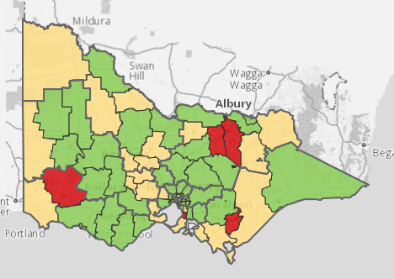
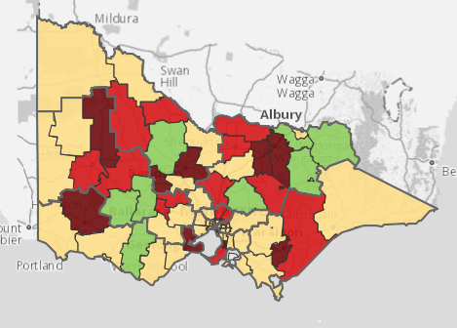
Self-harm hospital admissions (rate per 1000)
Men
Women
Source: Women’s Health Atlas

Slide 9
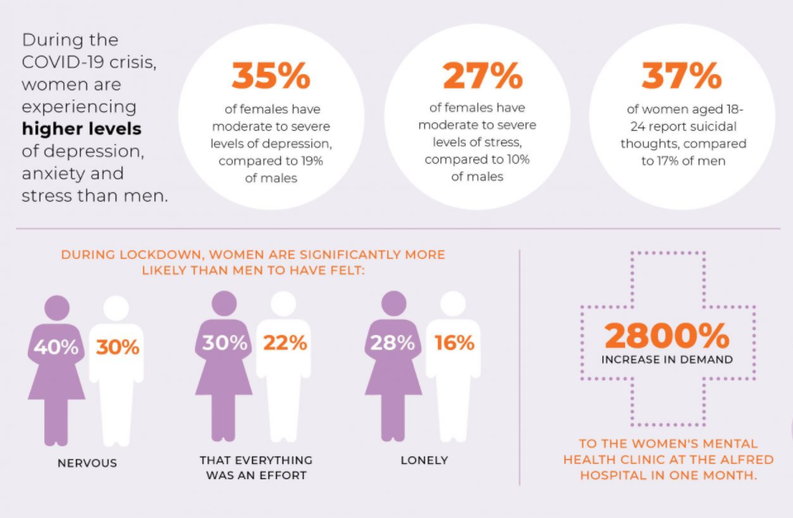
Women’s Mental Health During COVID-19

Slide 10
Chronic Disease and Avoidable Mortality

Slide 11
Cancer
Impact of COVID-19
Not all women have equal access to cancer screening and treatment services, which increases their risk.

Slide 12
Current Funding
This level of illness will cost
$41.2 BILLION
Women’s health services only have $2.05 per Victorian Woman to prevent all of these emerging illnesses
They are only able to reach 16% of Victorian Women on this Funding

Slide 13
We are asking for real investment, not small change.
We are calling for a per woman increase of $5.75 to fund urgent health prevention and promotion programs and for first time, dedicated investments for women with disabilities, Indigenous women and LGBTIQ women and trans and gender diverse people, as well as a boost to migrant and refugee women.
+

